Slide 1
Chp. 2: Atoms and the Periodic Table
Study Guide

Slide 2
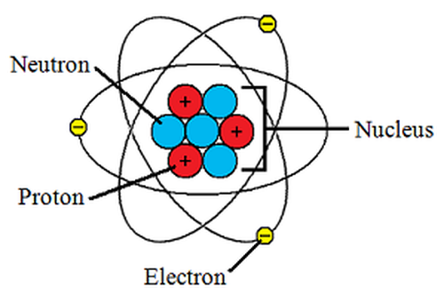
Parts of an atom
Protons: In the nucleus, has a positive charge
Neutron: In the nucleus, has a neutral charge
Electron: Orbits the nucleus, has a negative charge

Slide 3
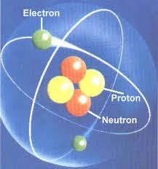
Charge of an atom
All atoms in their basic form are neutral because they have the same number of protons (positive) and the same number of electrons (negative).
2(-)
2(+)

Slide 4
Electrons
Electrons are found in the electron cloud/energy levels
Each energy level has a maximum number of electrons it can hold: 2 electrons in the first level, 8 in the second level, and 18 in the 3rd level.
An element will not bond with another element if their outermost energy level is full (it is chemically stable).
The electrons in the outer part of the last level of an atom are called valence electrons. These are the electrons that can be shared with other atoms to form bonds.
The mass of an electron is very small.

Slide 5
Ions
When an atom loses a valence electron it becomes positively charged (+) because now it has more protons.
When an atom gains a valence electron it becomes negatively charged (-) because now it has more electrons.

Slide 6
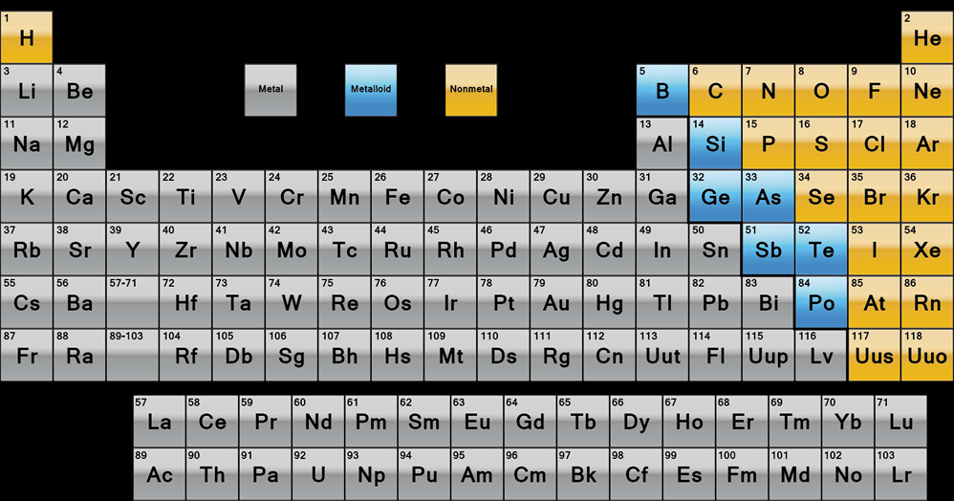
Periodic Table of Elements

Slide 7
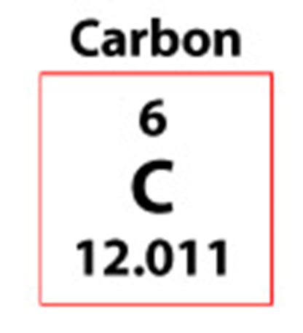
Parts of an Element Box
Element Name
Atomic Number
Element Symbol
Atomic Mass

Slide 8
Atomic Number/Atomic Mass
The atomic number is the number of protons the element has. This determines the identity of the element.
The atomic mass is the # of protons plus # of neutrons. (or atomic mass minus # of protons equals neutrons)

Slide 9
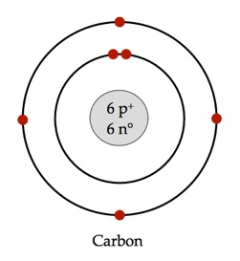
Bohr Model
When labeling an atom of an element the Bohr Model is the best way to represent the atom.
The Bohr Model for an element lists the # of protons and the # of neutrons in a box (the nucleus), and rings representing energy levels with electrons
Ex: Bohr Model for Carbon

Slide 10
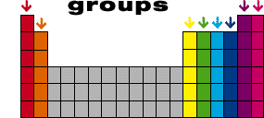
Element Group
Groups are vertical columns (up and down) on the Periodic Table of Elements.
All elements in a group have the same number of valence electrons.
Elements in the same group share common chemical properties.
(Ex. Group 18=Helium, Neon, Argon, Krypton, Xenon, Radon are all Noble Gases)

Slide 11
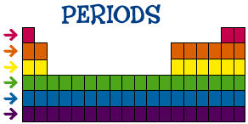
Element Period
Periods are horizontal rows (left to right) on the Periodic Table of Elements.
All elements in a period have the same number of energy levels for electrons.

Slide 12
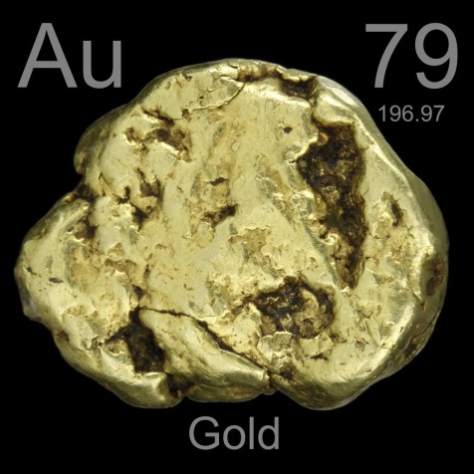
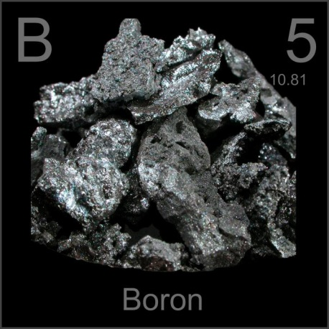
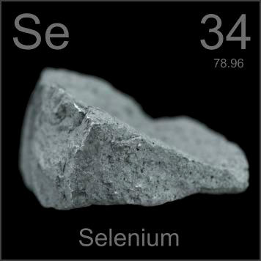
3 Categories
Elements on the periodic table can be broken into 3 categories: metals, metalloids, and non-metals.
Examples:
metal
metalloid
non-metal

Slide 13
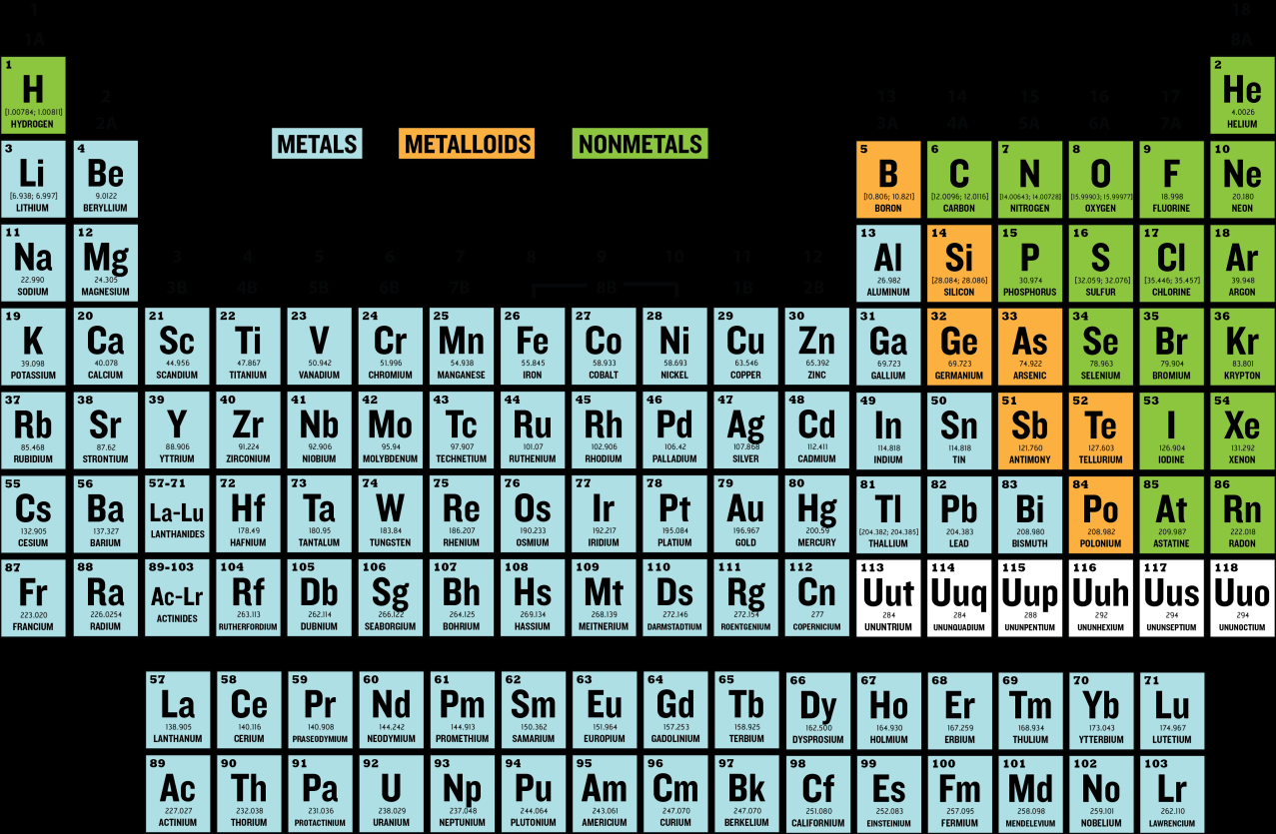
Metals
Metals=blue on this
table
metals have a shiny
luster
good conductor of heat
and electricity
high melting point
solid at room temp.
malleable

Slide 14
Metalloids
Metalloids=orange on
this table
share same
characteristics/properties
of both

Slide 15
Non-metals
Metals=green on this
table
non-metals have a
dull luster
bad conductor of heat
and electricity
low melting point
gas at room temp.
brittle

